Slide 1

Chapter 3
Data and Signals
Copyright © The McGraw-Hill Companies, Inc. Permission required for reproduction or display.

Slide 2

Note
To be transmitted, data must be transformed to electromagnetic signals.

Slide 3
3-1 ANALOG AND DIGITAL
Data can be analog or digital. The term analog data refers to information that is continuous; digital data refers to information that has discrete states. Analog data take on continuous values. Digital data take on discrete values.
Topics discussed in this section:
Analog and Digital Data Analog and Digital Signals Periodic and Nonperiodic Signals

Slide 4
Note
Data can be analog or digital. Analog data are continuous and take continuous values.
Digital data have discrete states and take discrete values.

Slide 5
Note
Signals can be analog or digital. Analog signals can have an infinite number of values in a range; digital signals can have only a limited number of values.

Slide 6
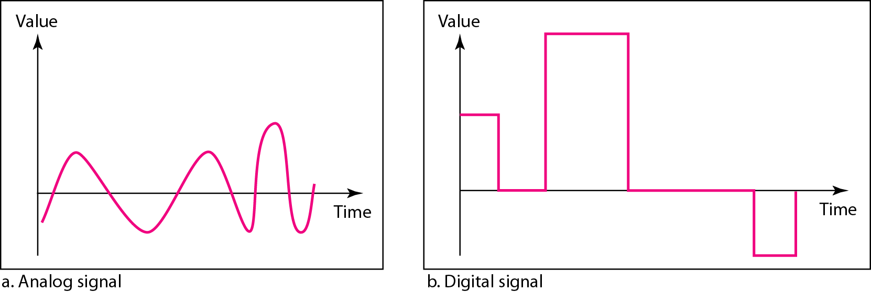
Figure 3.1 Comparison of analog and digital signals

Slide 7
Note
In data communications, we commonly use periodic analog signals and nonperiodic digital signals.

Slide 8
3-2 PERIODIC ANALOG SIGNALS
Periodic analog signals can be classified as simple or composite. A simple periodic analog signal, a sine wave, cannot be decomposed into simpler signals. A composite
periodic analog signal is composed of multiple sine waves.
Topics discussed in this section:
Sine Wave Wavelength Time and Frequency Domain Composite Signals
Bandwidth

Slide 9
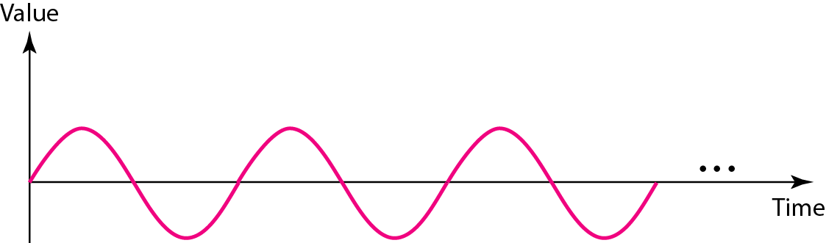
Figure 3.2 A sine wave

Slide 10
Characteristics of sine wave
Amplitude
Phase
frequency

Slide 11
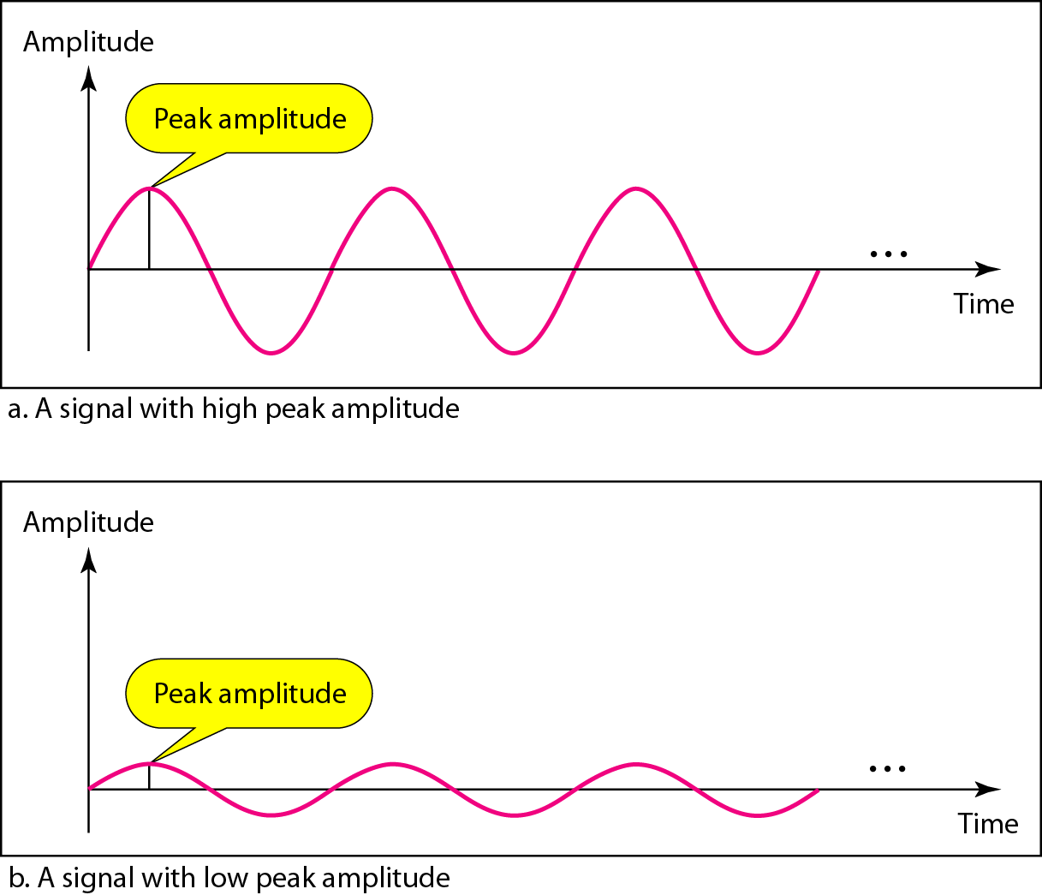
Figure 3.3 Two signals with the same phase and frequency, but different amplitudes

Slide 12

Note
Frequency and period are the inverse of each other.

Slide 13
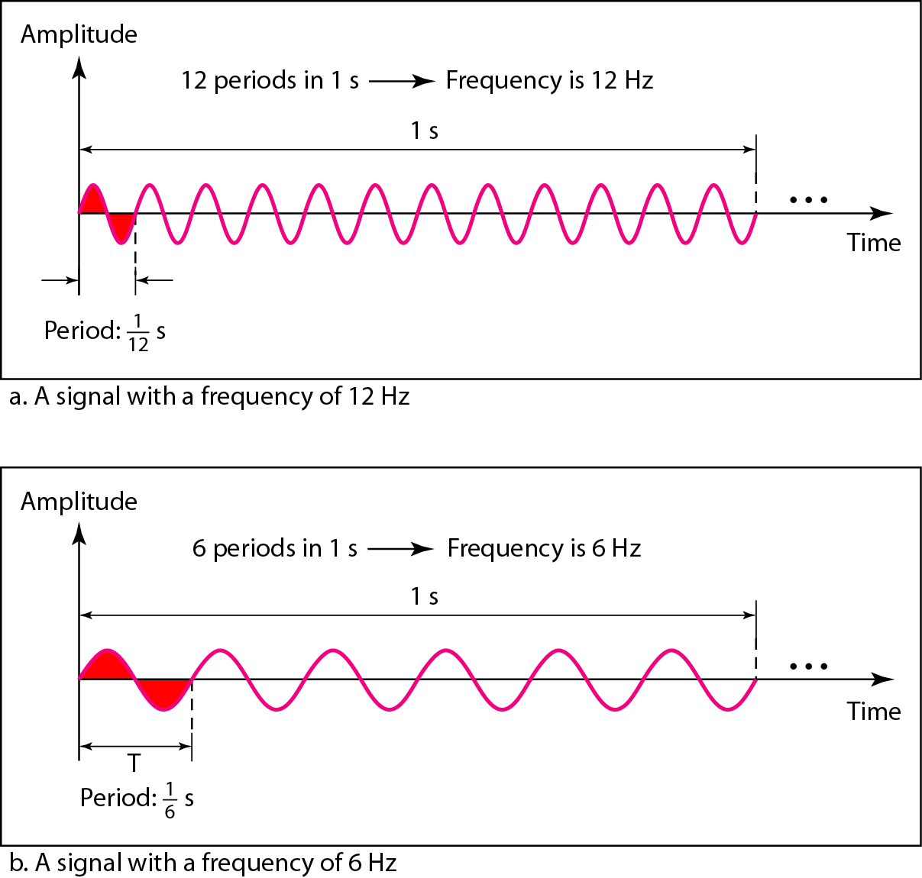
Figure 3.4 Two signals with the same amplitude and phase, but different frequencies

Slide 14
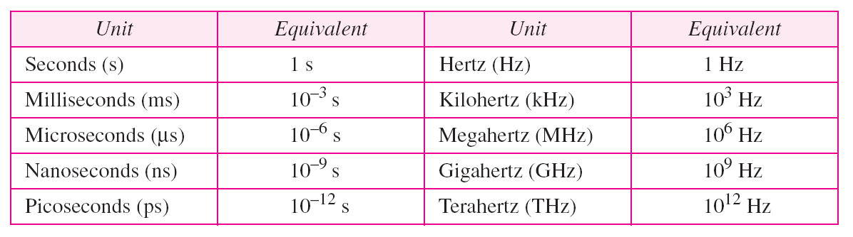
Table 3.1 Units of period and frequency

Slide 15
Note
Frequency is the rate of change with respect to time. Change in a short span of time
means high frequency. Change over a long span of time means low frequency.

Slide 16
Note
If a signal does not change at all, its frequency is zero.
If a signal changes instantaneously, its frequency is infinite.

Slide 17
Note
Phase describes the position of the waveform relative to time 0.

Slide 18
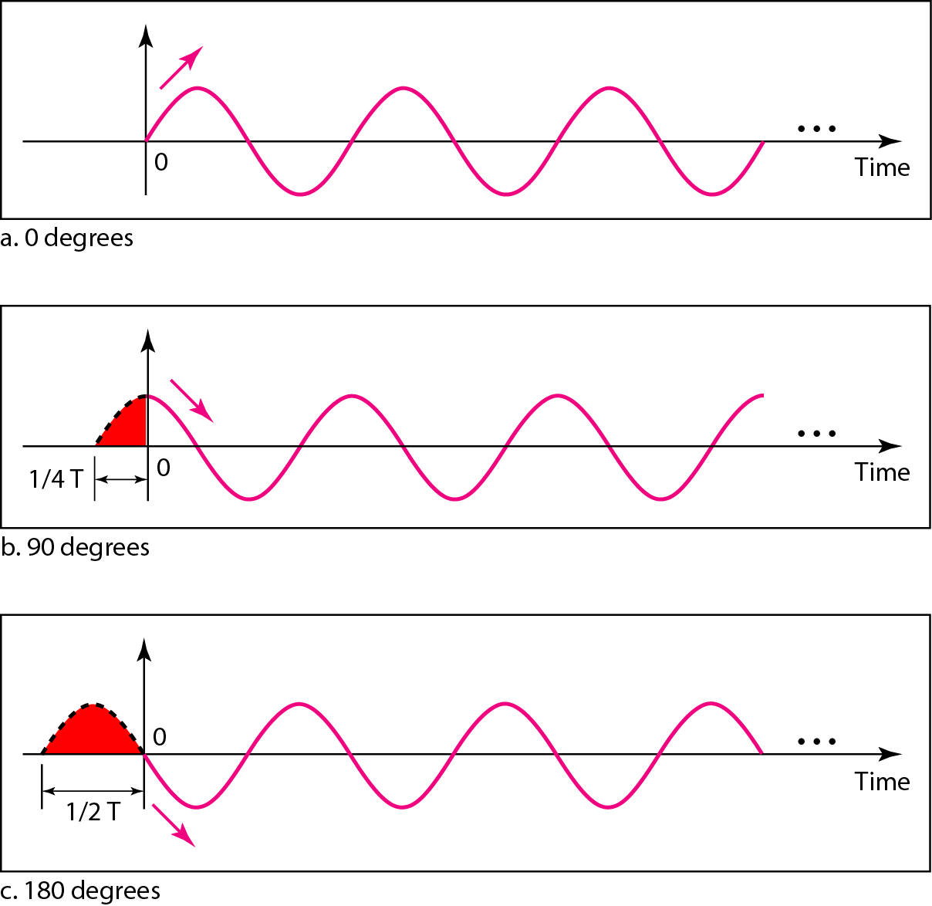
Figure 3.5 Three sine waves with the same amplitude and frequency, but different phases

Slide 19
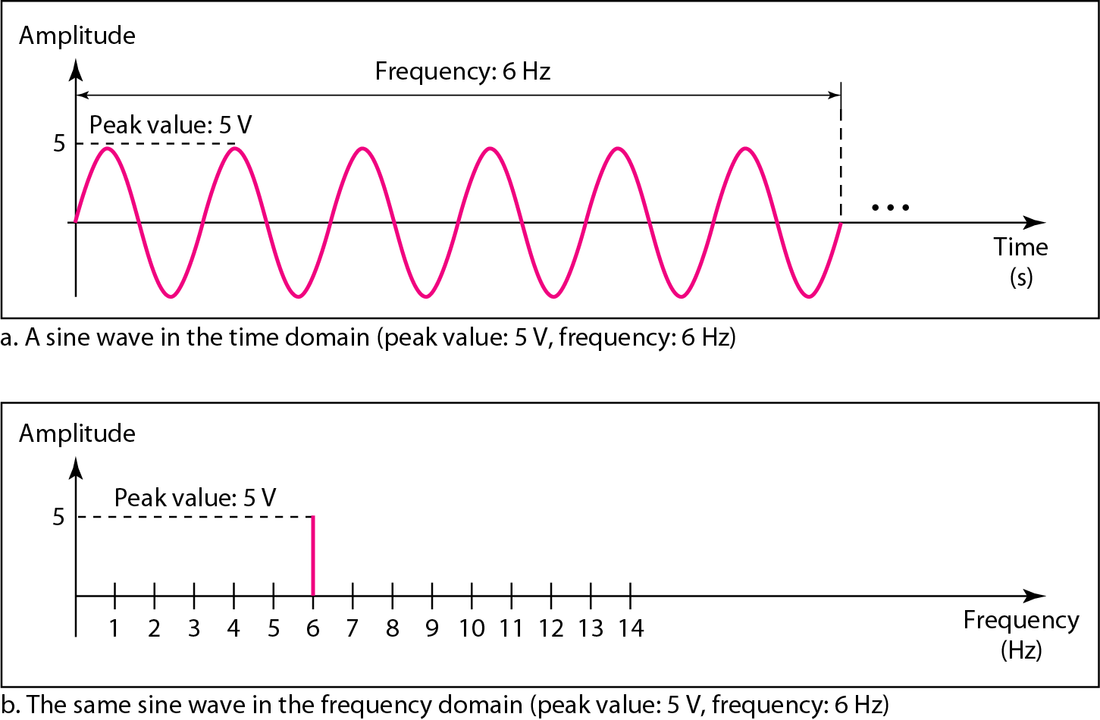
Figure 3.7 The time-domain and frequency-domain plots of a sine wave

Slide 20
Note
A complete sine wave in the time domain can be represented by one single spike in the frequency domain.

Slide 21
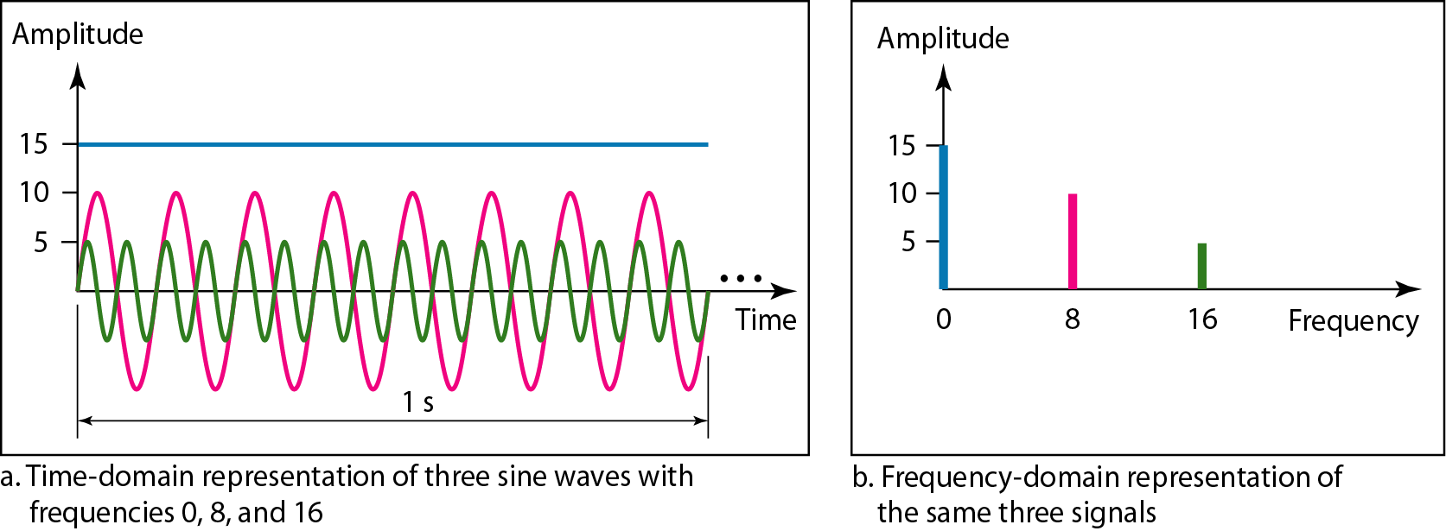
Figure 3.8 The time domain and frequency domain of three sine waves

Slide 22
Note
A single-frequency sine wave is not useful in data communications;
we need to send a composite signal, a signal made of many simple sine waves.

Slide 23
Note
The bandwidth of a composite signal is the difference between the
highest and the lowest frequencies contained in that signal.

Slide 24
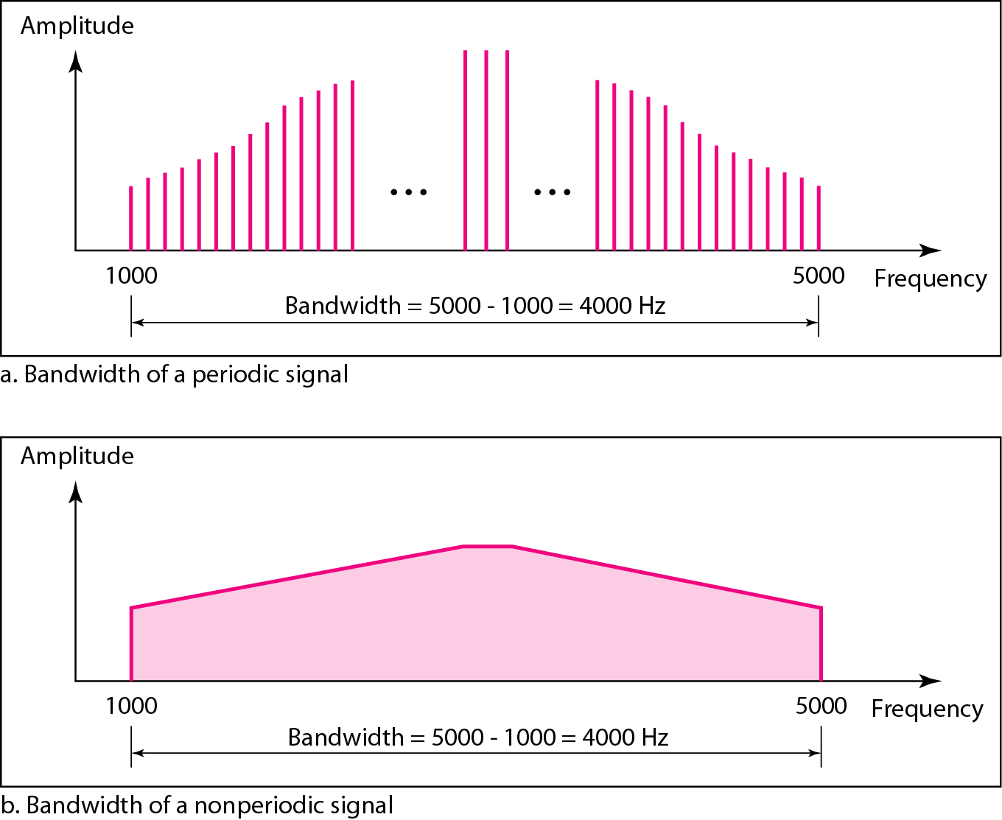
Figure 3.12 The bandwidth of periodic and nonperiodic composite signals

Slide 25
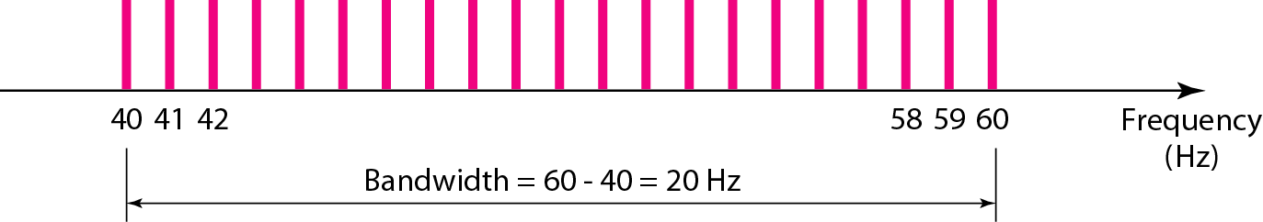
Figure 3.14 The bandwidth for Example 3.11

Slide 26
3-3 DIGITAL SIGNALS
In addition to being represented by an analog signal, information can also be represented by a digital signal. For example, a 1 can be encoded as a positive voltage and a 0 as zero voltage. A digital signal can have more than two levels. In this case, we can send more than 1 bit for each level.
Topics discussed in this section:
Bit Rate Bit Length

Slide 27
Bit rate
Number of bits sent in one second.
The term bit rate is used instead of frequency for digital signals.
Bit length
Is the distance one bit occupies on transmission medium.

Slide 28
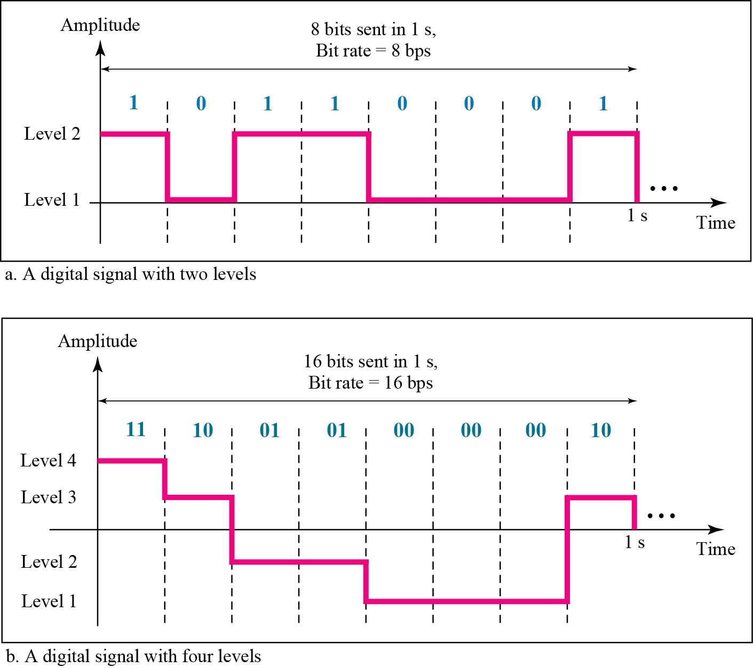
Figure 3.16 Two digital signals: one with two signal levels and the other with four signal levels

Slide 29
3-4 TRANSMISSION IMPAIRMENT
Signals travel through transmission media, which are not perfect. The imperfection causes signal impairment. This means that the signal at the beginning of the medium is not the same as the signal at the end of the medium. What is sent is not what is received. Three causes of impairment are attenuation, distortion, and noise.
Topics discussed in this section:
Attenuation Distortion Noise

Slide 30
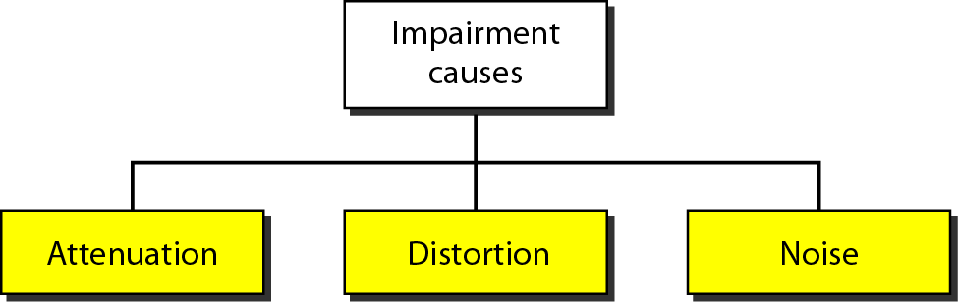
Figure 3.25 Causes of impairment

Slide 31
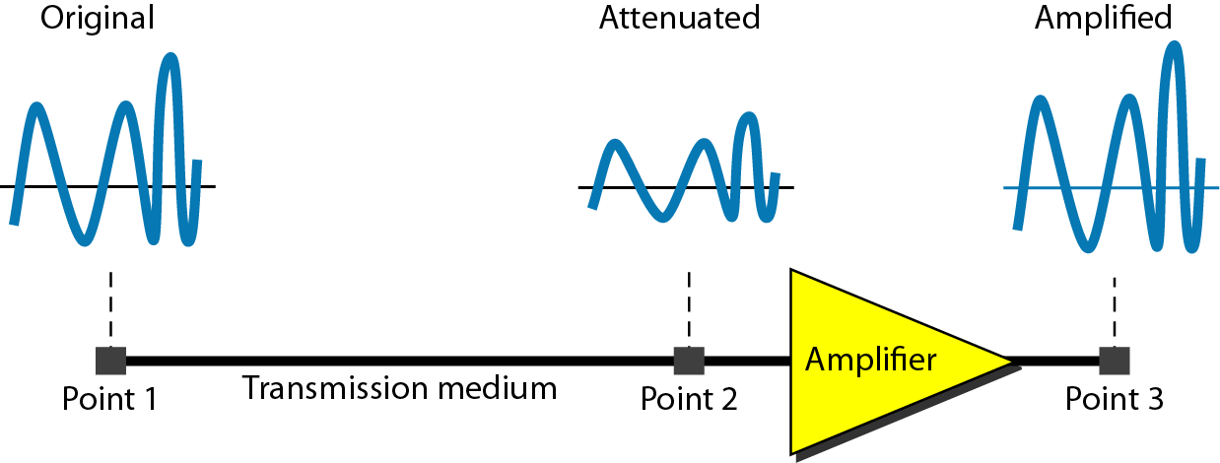
Figure 3.26 Attenuation

Slide 32
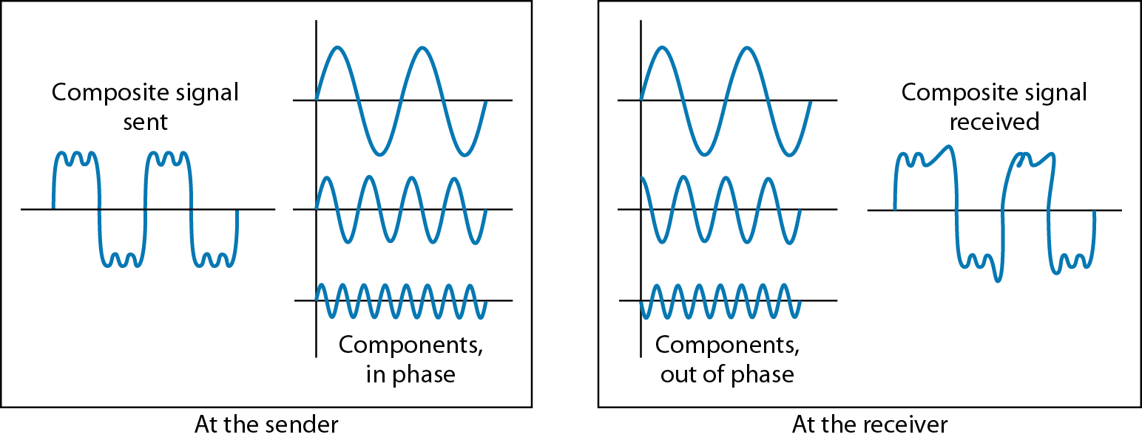
Figure 3.28 Distortion

Slide 33
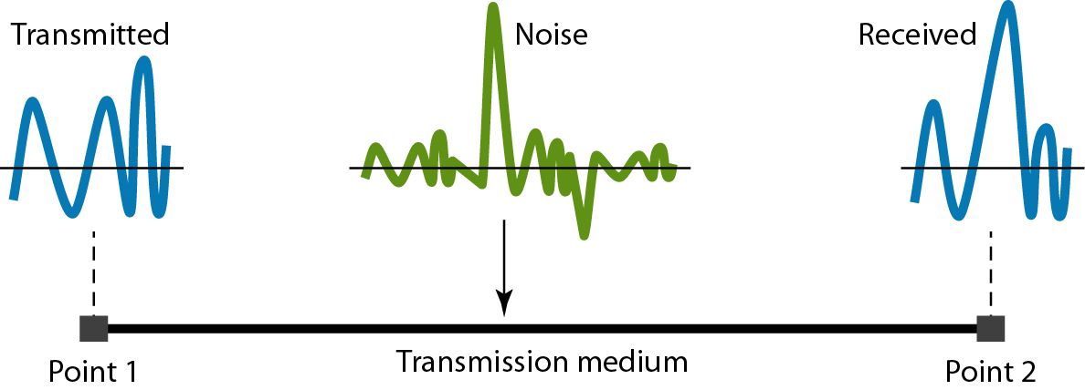
Figure 3.29 Noise

Slide 34
3-6 PERFORMANCE
One important issue in networking is the performance of the network—how good is it? We discuss quality of service, an overall measurement of network performance, in greater detail in Chapter 24. In this section, we introduce terms that we need for future chapters.
Topics discussed in this section:
Bandwidth Throughput Latency (Delay)
Bandwidth-Delay Product

Slide 35
Note
In networking, we use the term bandwidth in two contexts.
❏ The first, bandwidth in hertz, refers to the range of frequencies in a composite signal or the range of frequencies that a channel can pass.
❏ The second, bandwidth in bits per second, refers to the speed of bit transmission in a channel or link.

Slide 36
Throughput
Is define as ”how fast we can actually send data”
Delay
How long it takes for an entire message to completely arrive at the destination from the time the first bit is sent out from the source,

Slide 37
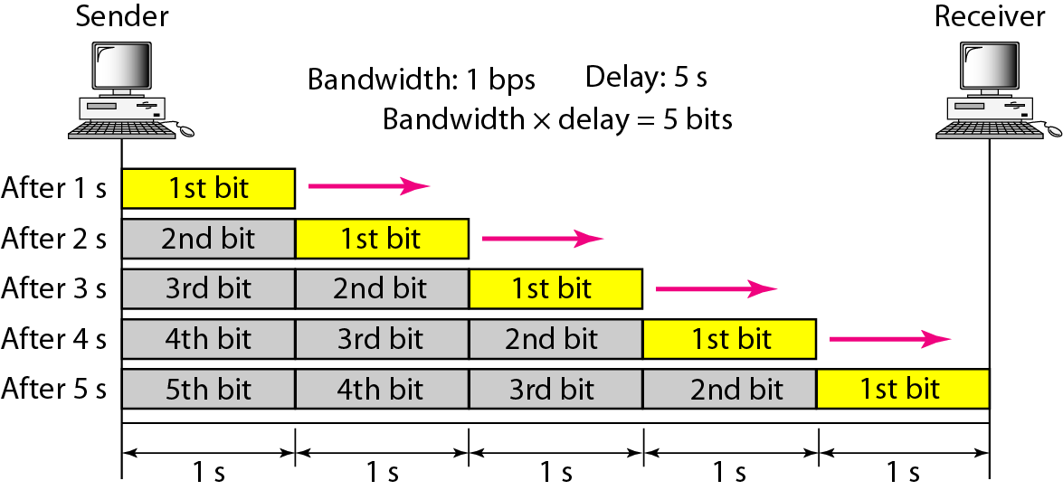
Figure 3.31 Filling the link with bits for case 1

Slide 38
Note
The bandwidth-delay product defines the number of bits that can fill the link.

